Slide 1

7th edition
Welcome and aims
Notes:
We acknowledges the Traditional Custodians of Country throughout Australia and recognise the continuing connection to lands, waters and communities. We pay our respect to Aboriginal and Torres Strait Islander cultures and to Elders both past and present.
https://www.8ways.online/our-protocol
Image:https://www.abc.net.au/news/2018-07-06/school-children-singing-could-save-indigenous-language/9940118
For use with with APLS ANZ 6e Manual 2017

Slide 2

Notes:
We acknowledge the traditional owners of the land on which we meet – the Gadigal people of the Eora Nation. We recognise their continuing connection to land, waters and culture. We pay our respects to their Elders, past, present and emerging. Together we re-state our shared commitment to advancing Aboriginal and Torres Strait Islander health and education as core business of APLS.

Slide 3
APLS refresher program
To consolidate the knowledge necessary for
effective treatment and stabilisation of children with life threatening emergencies
To review the practical procedures necessary
for effective management of childhood
emergencies
To assess and provide feedback to support acquisition of these skills

Slide 4
Intros
Notes:
Activity: Ask the candidates to find the other members of their “coloured” group, sit together and take a few minutes to get to know each other.
Faculty briefly introduces themselves and states who they are mentoring. This includes the course coordinator who takes this opportunity to address any housekeeping.
Then ask everyone to briefly introduce themselves – consider asking what they would have done if they were not in their current profession.

Slide 5
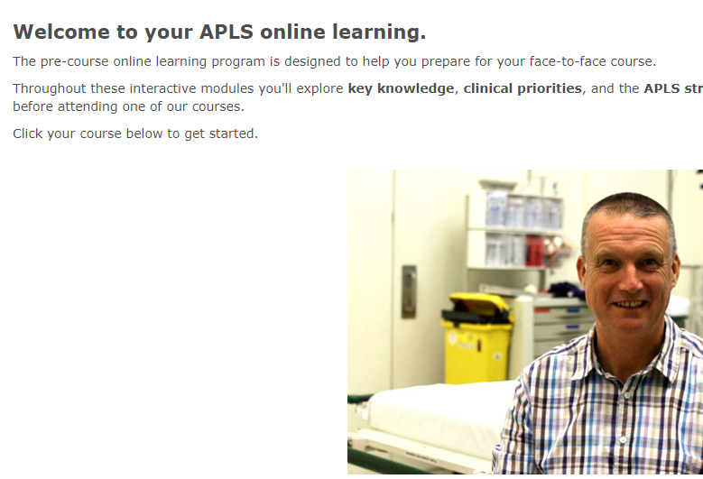

Pre-course
Pre-course online learning
Manual
Notes:
Pre-course online learning designed to draw out the clinical priorities of the APLS manual

Slide 6
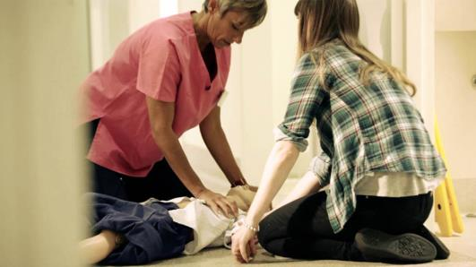
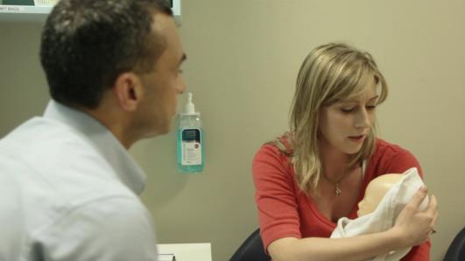
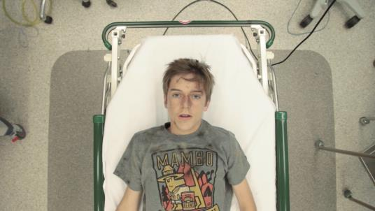
Format
Life support
Serious illness
Serious injury

Slide 7
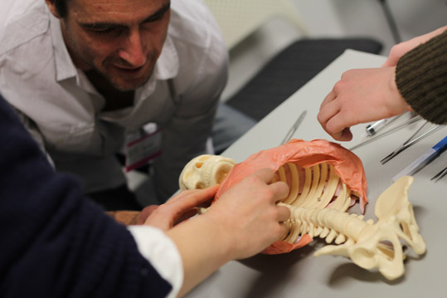
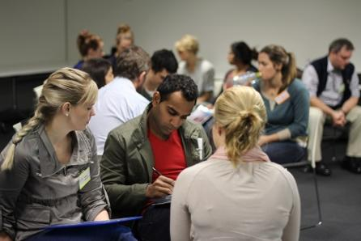
Refresher content
Practical
Skills stations
Notes:
Over the next 2 days we will further consolidate this theory, review the skills required to put this theory into practice

Slide 8
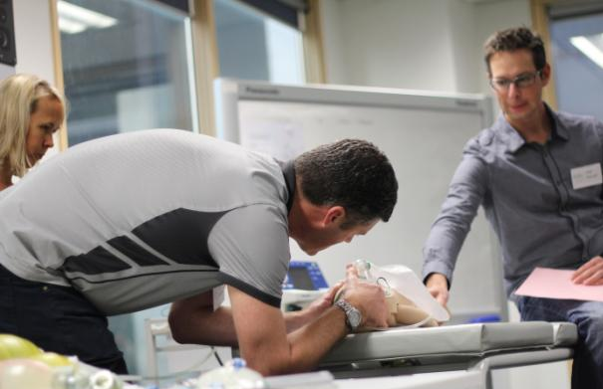
Refresher content
Practical
Scenarios
‘Hands on’
team leader
Notes:
Low fidelity scenarios, designed to consolidate learning when resources are limited.
More time is allocated to practicing structured approach in different clinical scenarios, followed by debriefing (12 mins scenario/ 8 mins group discussion of learning from the case). Time allowed to discuss the management of specific paediatric illnesses in greater detail
Acknowledge stress of ‘performing’ in front of peers
Need candidates to ‘suspend belief’ to maximise the benefits from this form of learning.
Candidates will be expected to be a ‘hands on’ team leader:
Prepare for the case
Examine the manikin (to elicit clinical cues from instructor)
Guide the roles of their assistants (other members of their colour group)
Maintain responsibility for team member actions.

Slide 9
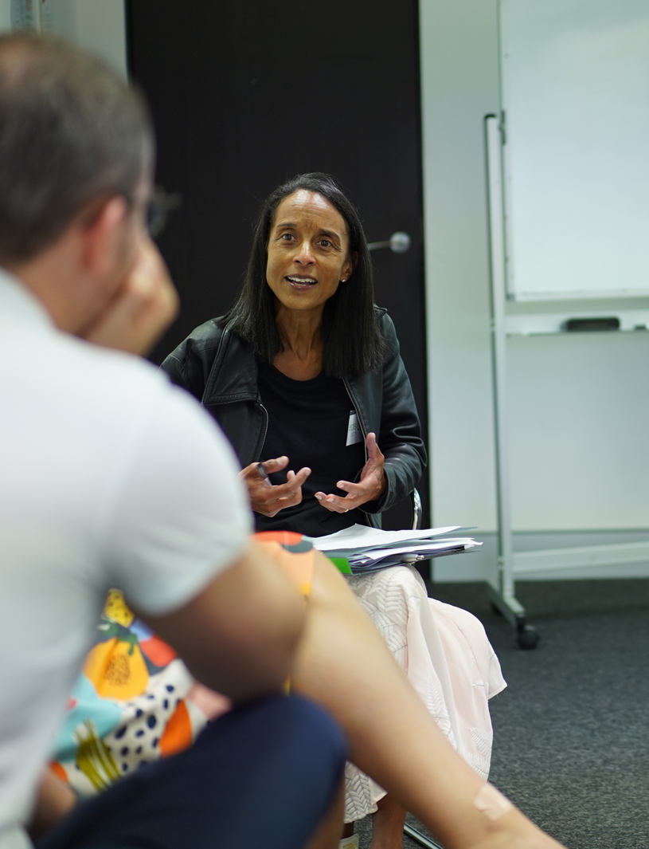
Educational support
Mentoring
Critiquing
Feedback and coaching
Notes:
The content of this is actually a good prompt

Slide 10
Educational support: assessment & feedback
BLS/ALS, Airway skills, Trauma skills:
Formative assessment - repeated intentional practice, opportunity for feedback
Scenario/experiential learning:
Formative assessment with coaching, feedback and repetitive practice
Notes:
Support further development of these skills with formative assessment, feedback and coaching

Slide 11
Respect & feeling safe
During the course you may:
  feel challenged
  be worried or anxious
  try new things
We recognise this and will be supportive
Notes:
See article about creating a Safe Container for simulation
https://journals.lww.com/simulationinhealthcare/Fulltext/2014/12000/Establishing_a_Safe_Container_for_Learning_in.2.aspx

Slide 12
Respect & feeling safe
We acknowledge that you
  are skilled, inquisitive and motivated
  bring a wealth of life & work experience
This course aims to enhance everyone’s learning - candidates and instructors
…by sharing, listening, respecting
Notes:
See article about creating a Safe Container for simulation
https://journals.lww.com/simulationinhealthcare/Fulltext/2014/12000/Establishing_a_Safe_Container_for_Learning_in.2.aspx

Slide 13

Expectations
You and Faculty
  Prepared
  read the manual
  pre-course online learning
  Attend all sessions on time
  Support your faculty and fellow candidates
  Enjoy yourself

Slide 14
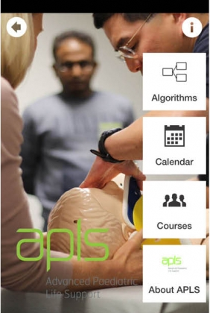
Post-course support
Access to website
APLS online learning for one month following the course
APLS app & algorithms
PAC conference on-demand, bite–size video updates, newsletters
APLS community of practice
Notes:
APLS feedback can be emailed to feedback@apls.org.au, or via online feedback forms.

Slide 15

Feedback
feedback@apls.org.au
or via online feedback forms
Notes:
APLS feedback can be emailed to feedback@apls.org.au, or via online feedback forms.

Slide 16
?

